Slide 1
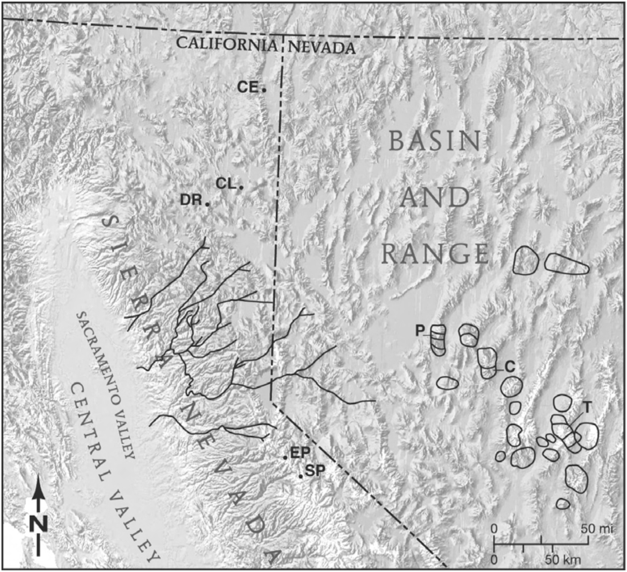
The Upper Reaches of the Sierra Nevada auriferous gold channels, California and Nevada
Garside et al., 2005
Presented by Luke J. Schranz

Slide 2
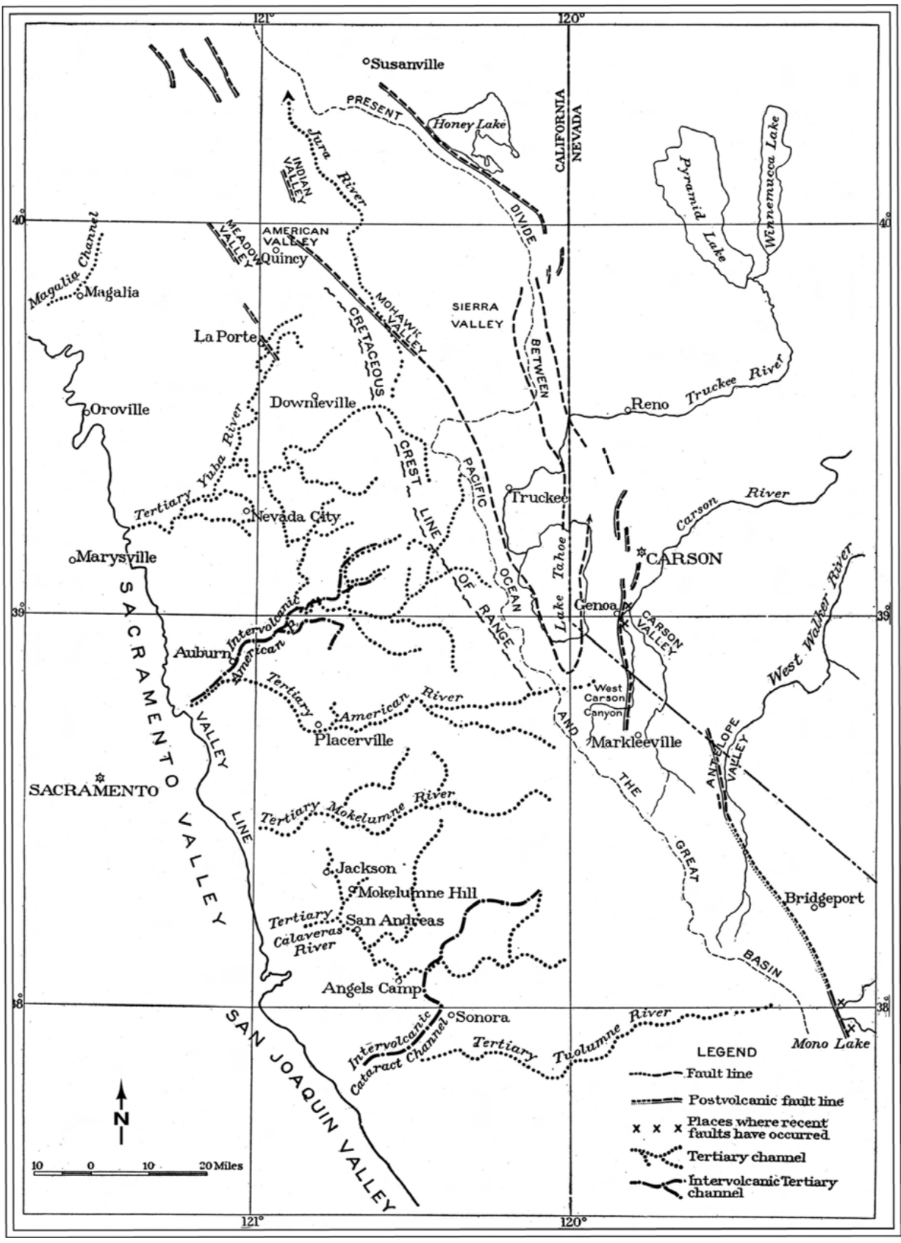
Lindgren’s 1911 Map

Slide 3
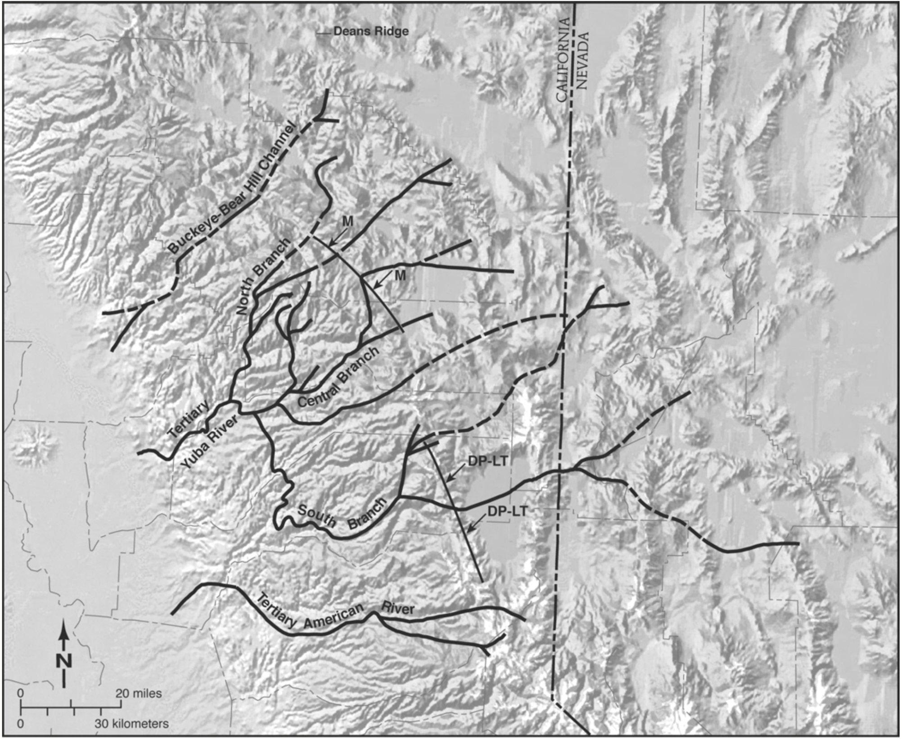

Slide 4
Geology
80-30 Ma major erosion
Material was eroded from a high (3+km in central NV) elevations to the east
Deposited in a marine basin in the now Central Valley
Oligocene (30-24Ma) tuffs cap eocene gravels in paleo-vallies

Slide 5
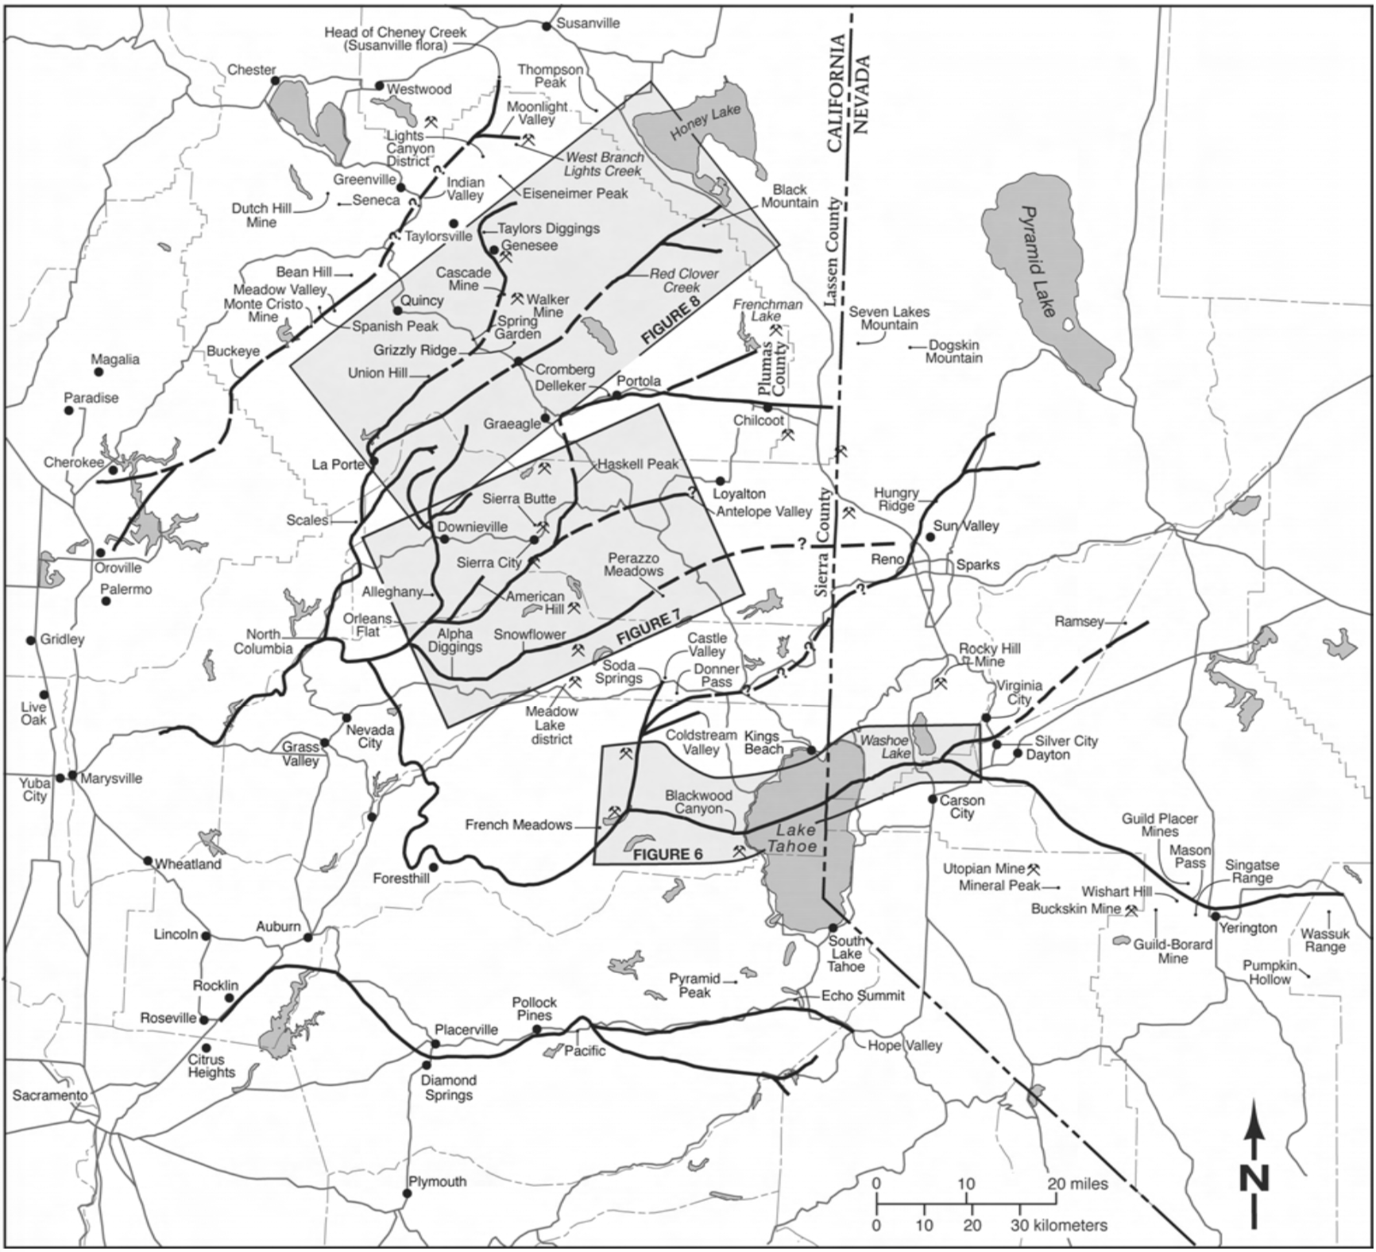

Slide 6
Gold in Gravels
Orogenic, milky quartz veins hosting gold sourced in the Sierra Nevada region
To the east, base metal vein type gold (porphry) is the main source

Slide 7
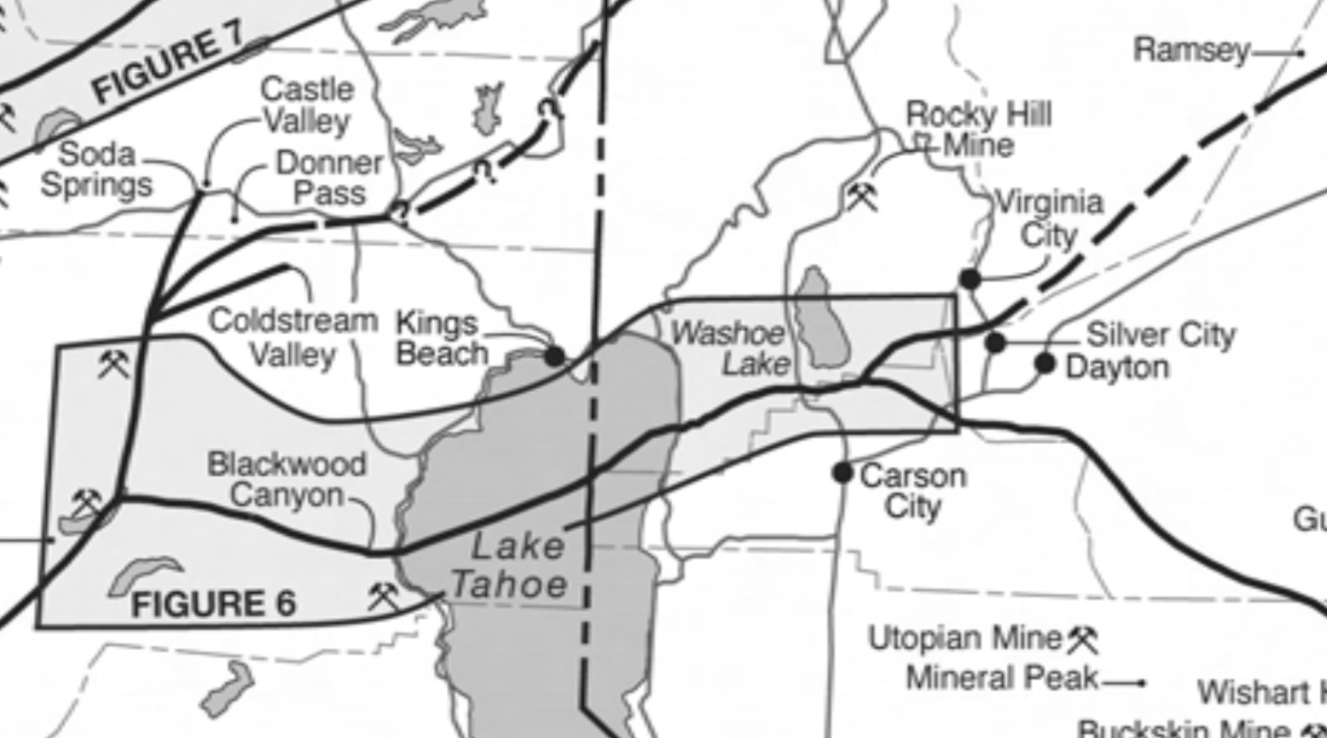
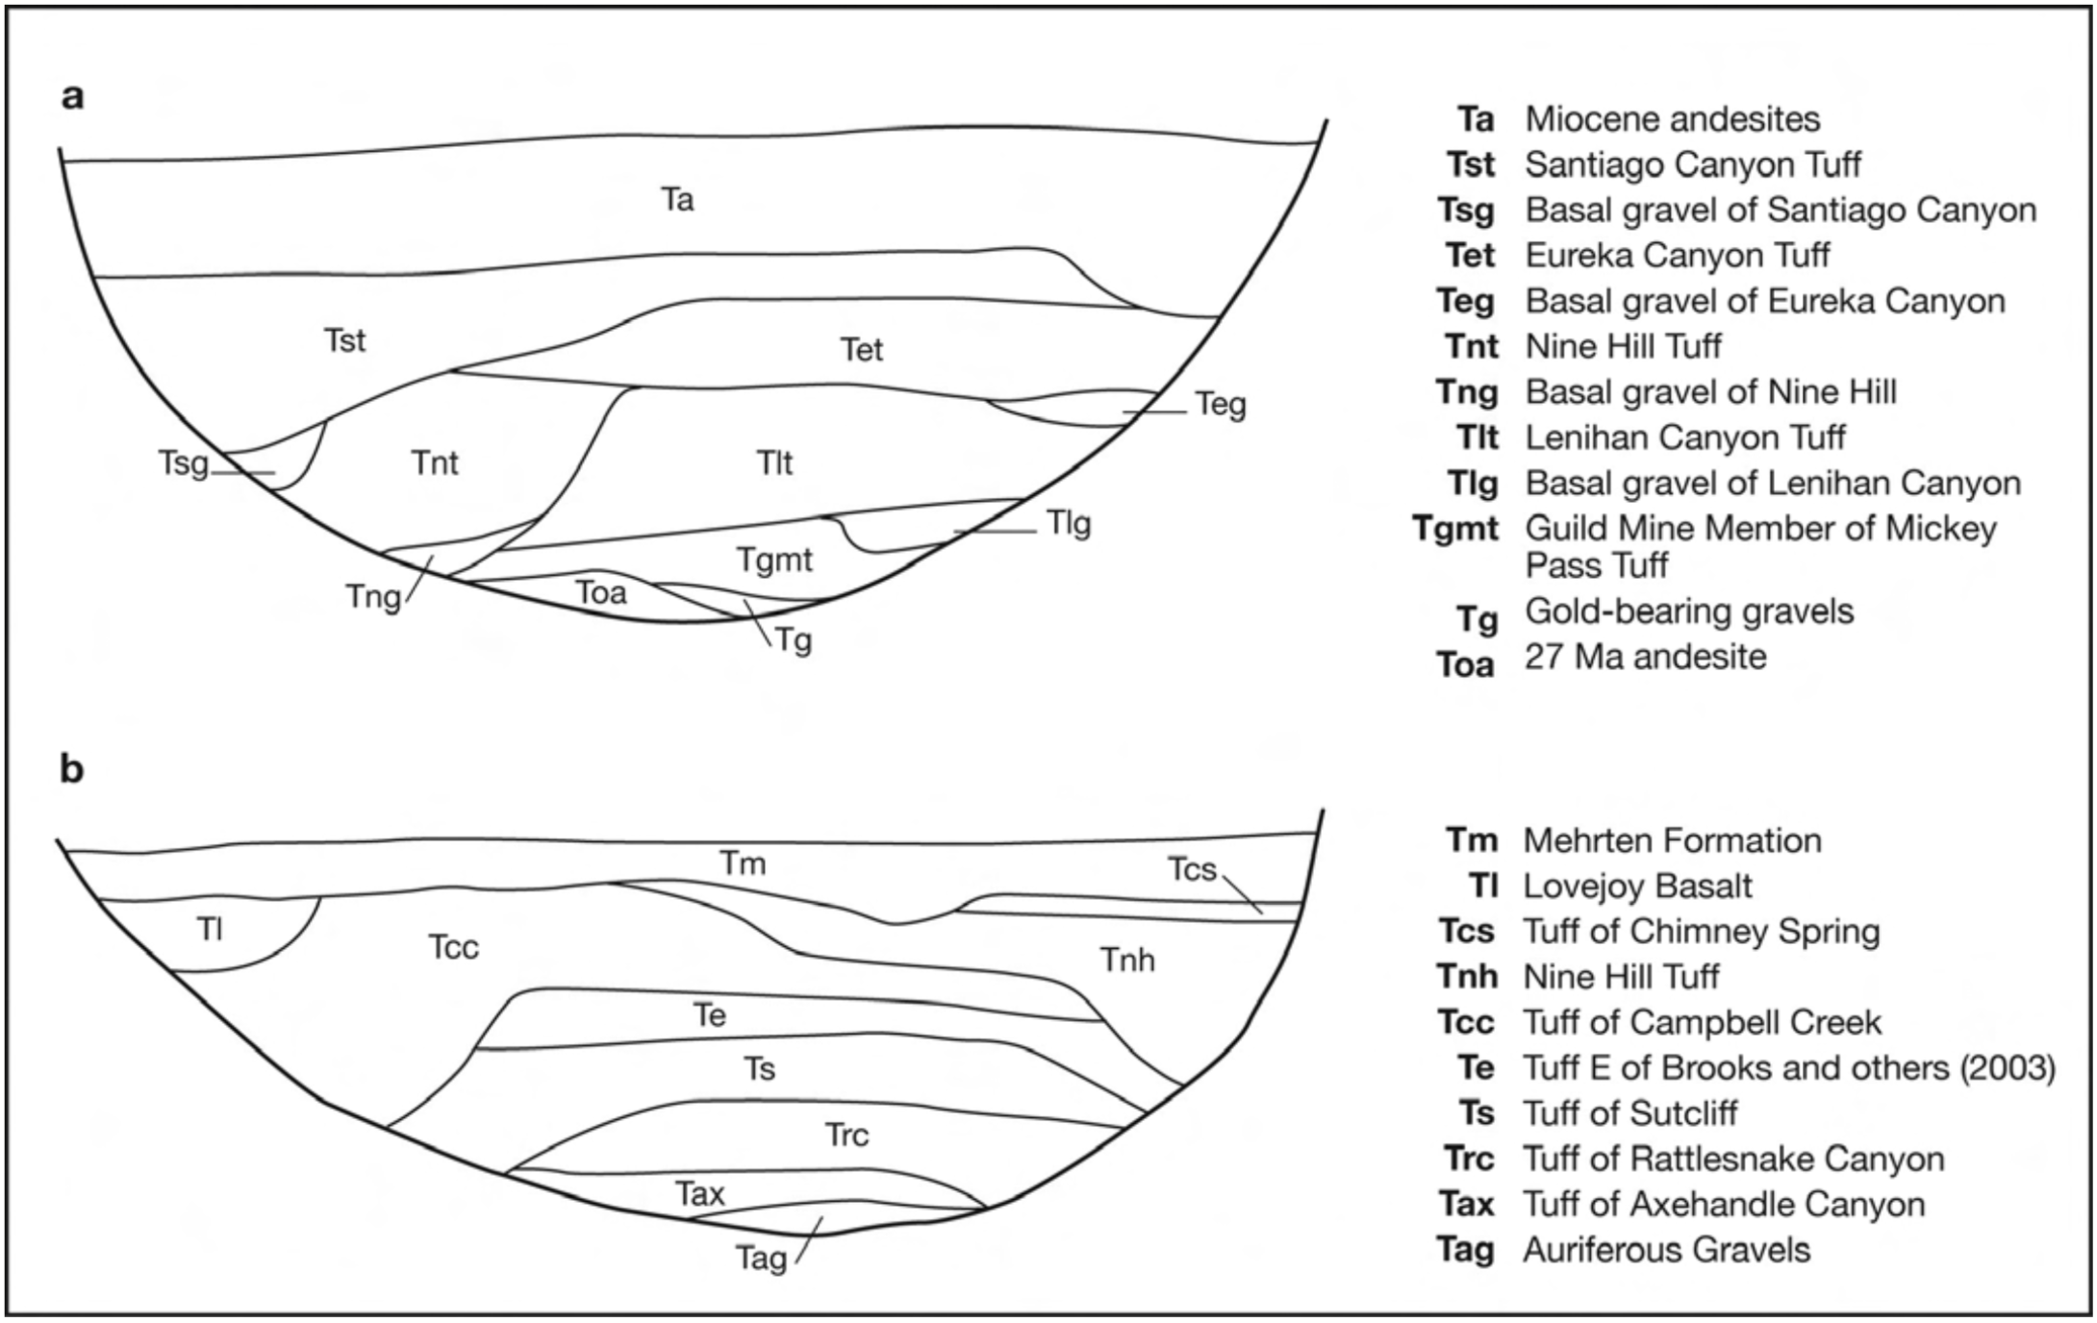

Slide 8
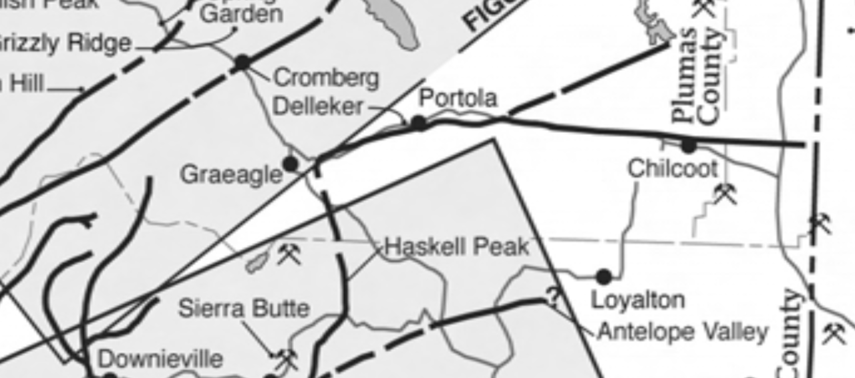

Slide 10
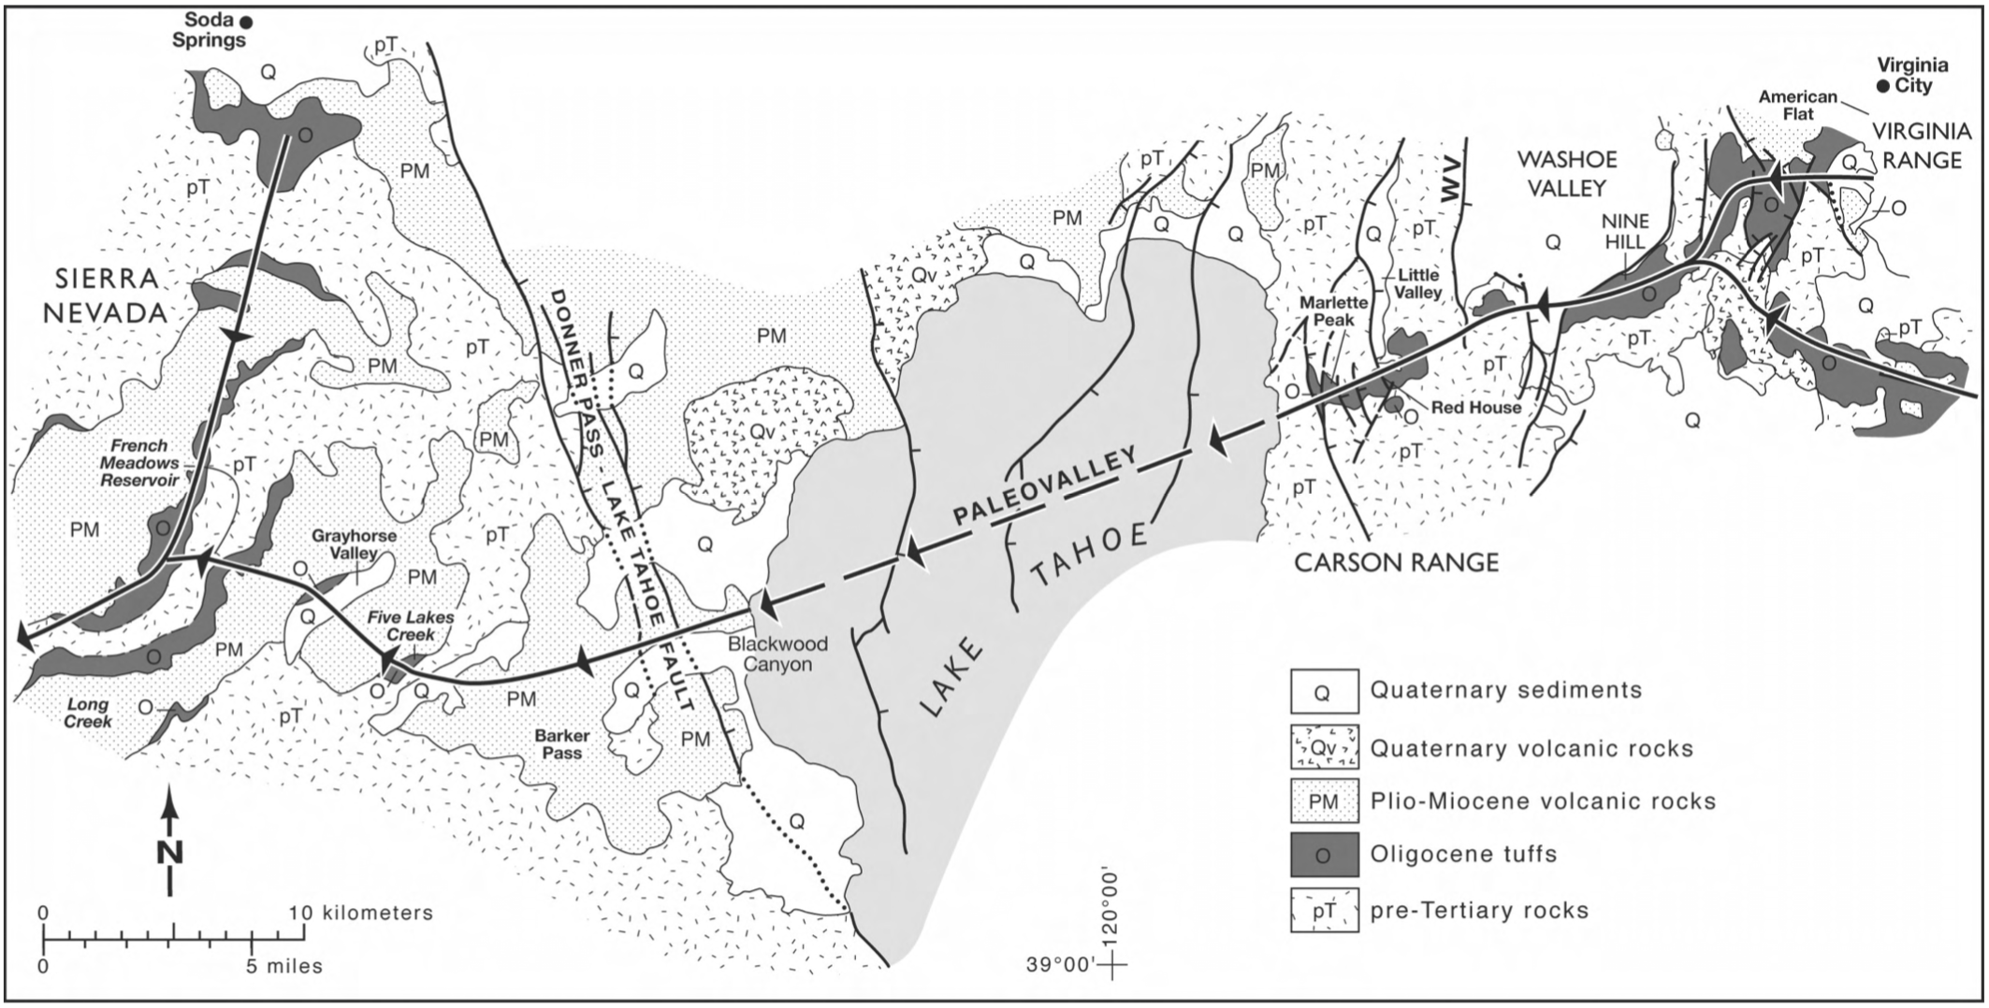

Slide 11
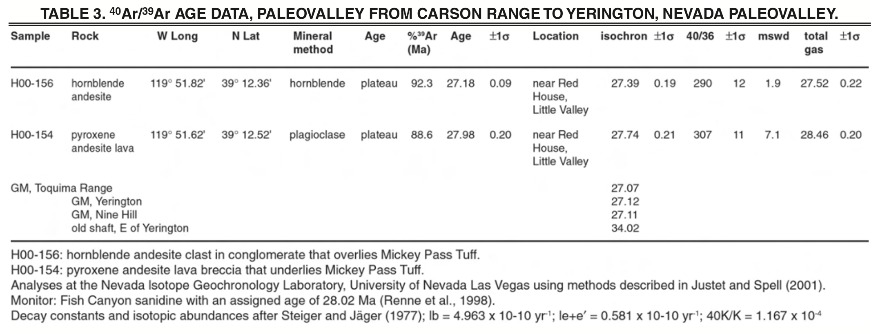

Slide 13
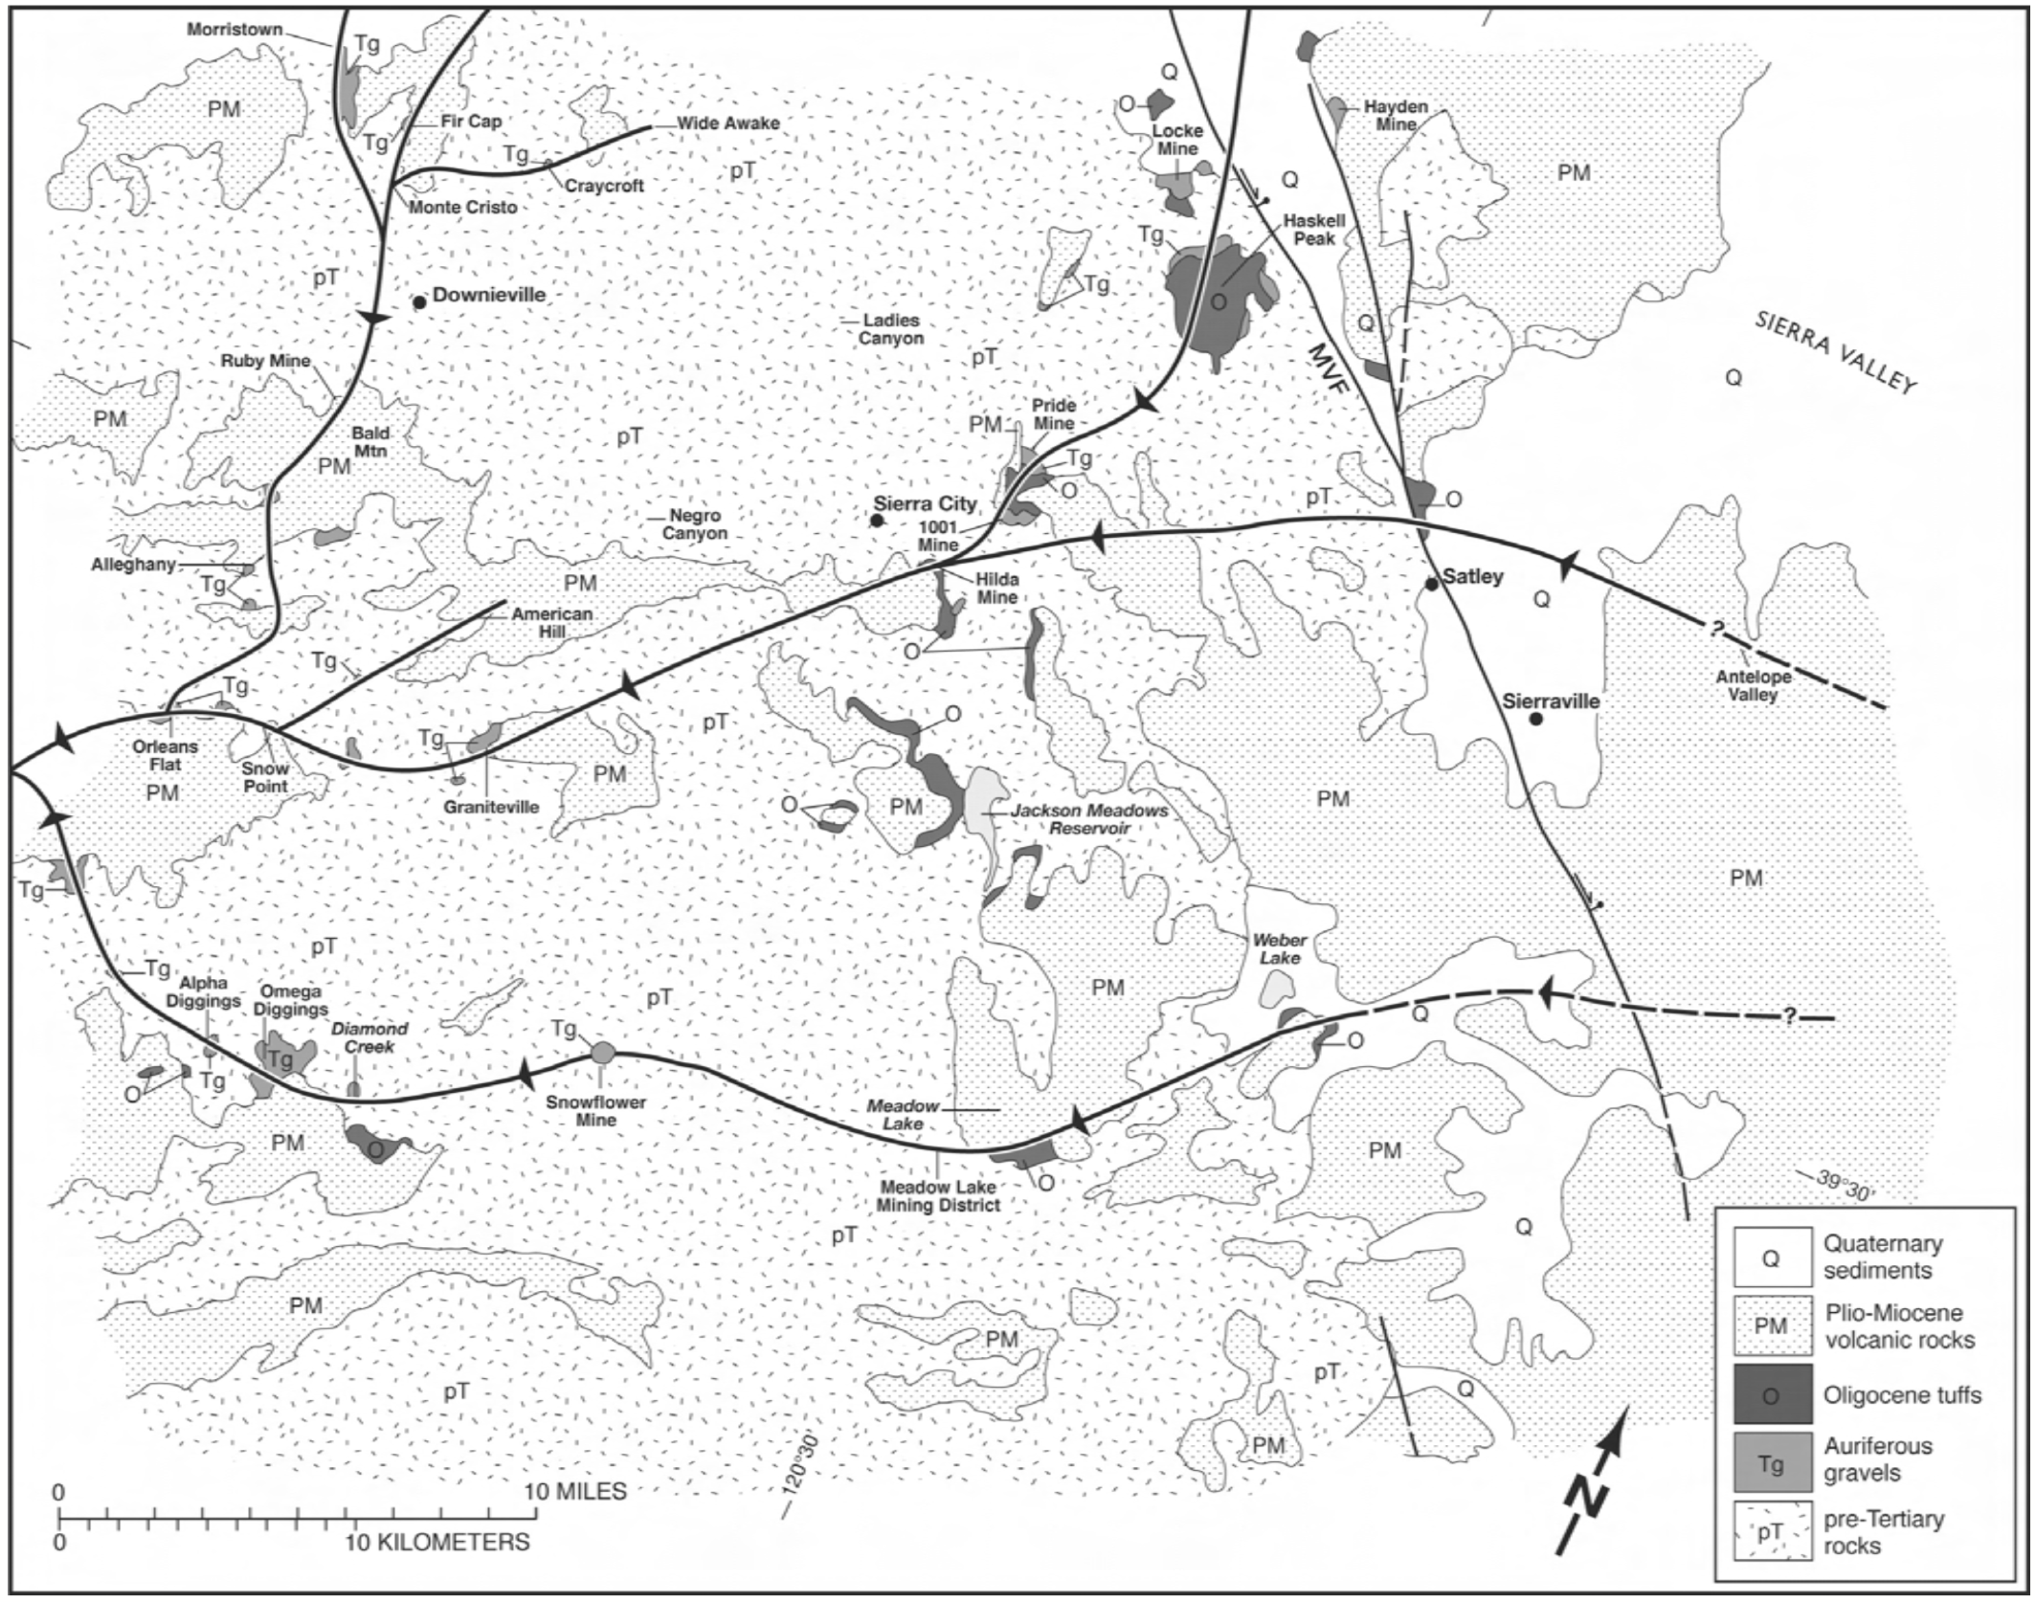

Slide 15
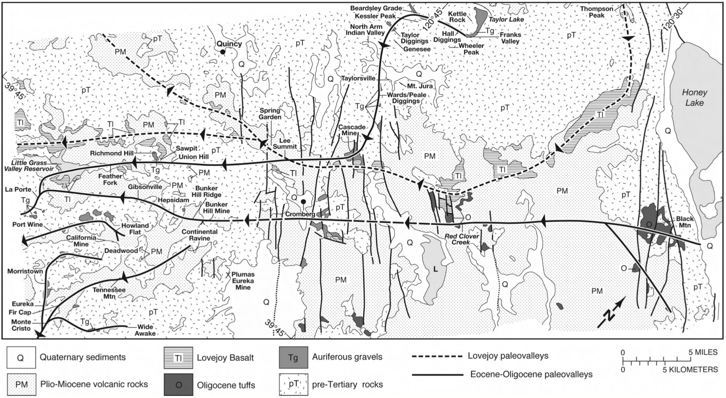

Slide 16
Conclusions and Questions
Major Eocene paleo-channels actually flowed from the north and much further from the east than previously described
Sierra Nevada was not high elevation as it is today during the Eocene
Additional gold sources in Nevada?

